Slide 1



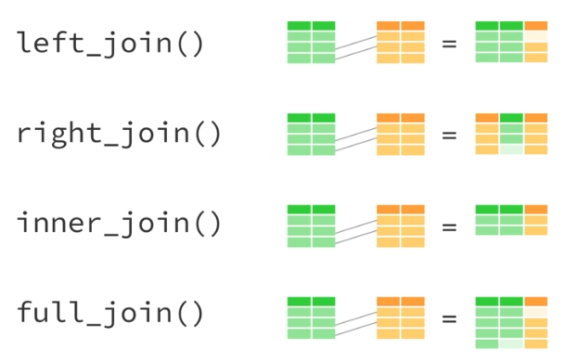
TRANSFORMING DATA IN R

Slide 2
TRANSFORMING DATA IN R
JOINS in dplyr
inner_join
return all rows from x where there are matching values in y, and all columns from x and y. If there are multiple matches between x and y, all combination of the matches are returned.
left_join
return all rows from x, and all columns from x and y. Rows in x with no match in y will have NA values in the new columns. If there are multiple matches between x and y, all combinations of the matches are returned
right_join
return all rows from y, and all columns from x and y. Rows in y with no match in x will have NA values in the new columns. If there are multiple matches between x and y, all combinations of the matches are returned
full_join
return all rows and all columns from both x and y. Where there are not matching values, returns NA for the one missing.
semi_join
return all rows from x where there are matching values in y, keeping just columns from x. A semi join differs from an inner join because an inner join will return one row of x for each matching row of y, where a semi join will never duplicate rows of x
anti_join
return all rows from x where there are not matching values in y, keeping just columns from x

Slide 3
TRANSFORMING DATA IN R
Pivoting Data
gather
takes multiple columns, and gathers them into key-value pairs: it makes “wide” data longer
spread
takes two columns (key & value) and spreads in to multiple columns, it makes “long” data wider
Lead and Lag
lead(x, n = 1L, default = NA, order_by = NULL, ...)
Find the "next" value in a vector x. Useful for comparing values ahead of the current values
lag(x, n = 1L, default = NA, order_by = NULL, ...)
Find the “previous" value in a vector x. Useful for comparing values behind the current values

